Slide 1
Predictive Analytics for Hospital Bed Occupancy Management
Name: Ali abdelmeneam abdel karim
Id: 21510563
Supervisor: Dr. Amira abdo

Slide 2
AGenda
• Background and Motivation
• Problem Statement
• Objectives and Aims
• Targeted Customers
• Planning the Project
• Literature Review
• Requirements and Analysis
• Tools Used
• Conclusion
• References

Slide 3
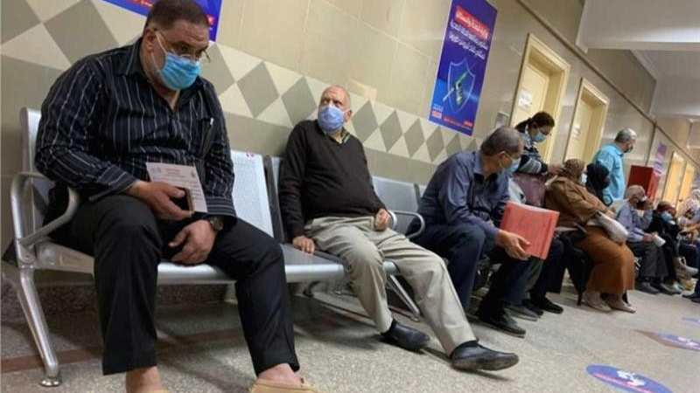
Background and Motivation
• Hospitals are facing challenges in managing bed occupancy due to unpredictable patient admissions.
• The need for improved resource management has become critical.
• Predictive analytics is increasingly being used to optimize hospital operations and improve patient care.

Slide 4
Problem Statement
• Overcrowding and underutilization of hospital beds are major issues.
• These issues lead to inefficient resource allocation and impact patient care which leads to Delays and stress on healthcare workers.
• Accurate forecasting of bed occupancy is needed to address these challenges.

Slide 5
Aims and objectives
1. Develop a predictive machine learning model for hospital bed occupancy.
2. Create an interactive dashboard for hospital administrators.
3. Improve decision-making through accurate data insights.

Slide 6
Targeted Customers
• Hospital administrators seeking to optimize bed occupancy.
• Healthcare providers interested in improving operational efficiency.
• Decision-makers aiming to enhance patient care quality.

Slide 7
Planning the Project
• Step 1: Data collection and preprocessing.
• Step 2: Model development and training using machine learning.
• Step 3: Dashboard design and integration.

Slide 8
Literature Review
• Existing models for hospital resource management.
• Machine learning techniques used for predictive analysis in healthcare.
• Gaps in current methods that need addressing.

Slide 9
Requirements and Analysis
• Functional Requirements: Predictive model, real-time predictions, dashboard visualization.
• Non-Functional Requirements: Usability, performance, security, and scalability.

Slide 10
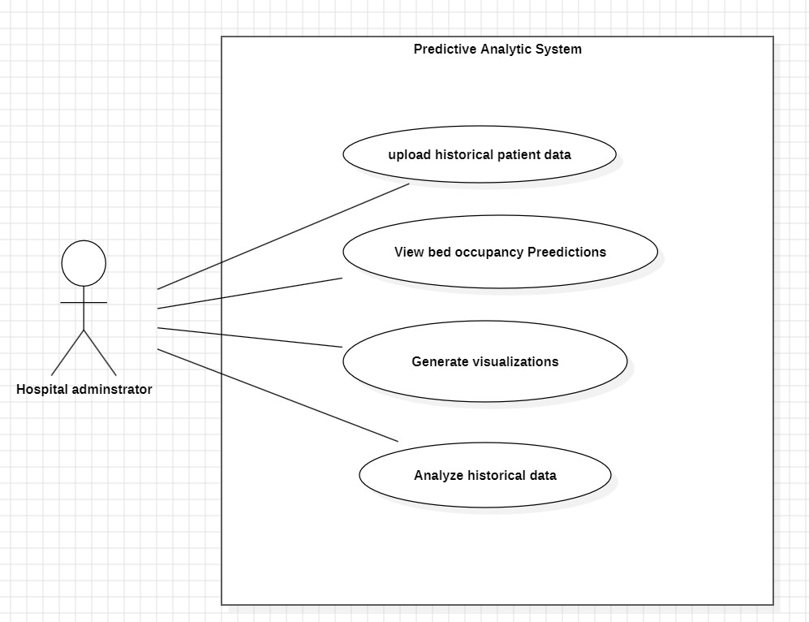
Use case diagram

Slide 11
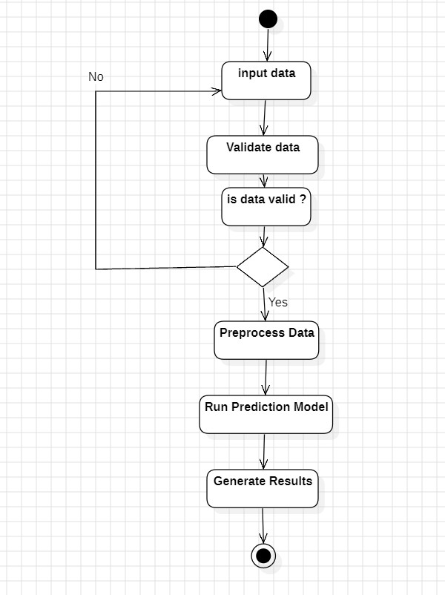
Activity diagram

Slide 12
Tools Used
• Python for data processing and machine learning (scikit-learn).
• Streamlit for building the interactive dashboard.
• Pandas and NumPy for data manipulation.

Slide 13
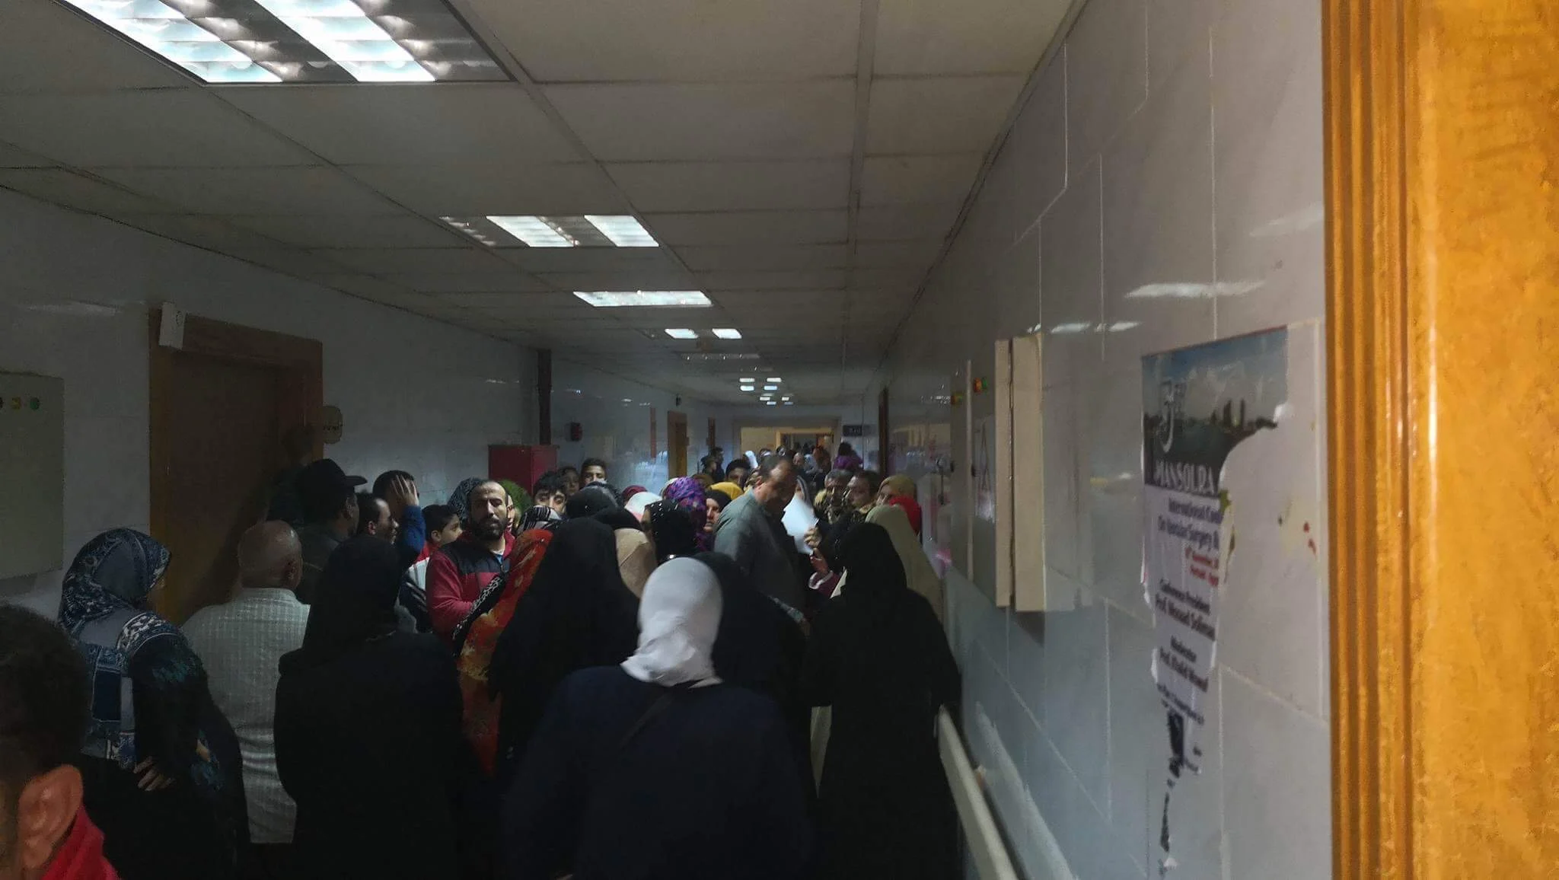
Conclusion
• Predictive analytics improves hospital operations and patient care.
• This project provides a reliable, scalable solution for bed occupancy management.

Slide 14
References
• Smith, J. (2020). Predictive Analytics in Healthcare. Journal of Medical Data.
• Fundamentals of data base systems, Ramez el masri (2006)
• Streamlit Documentation. (2023). Retrieved from https://docs.streamlit.io

Slide 15
Thank you

